Slide 1

Modern Programming Tools And Techniques-I
Lecture 5: Arrays

Slide 2
Array
Definition:
An array is a group/collection of variables of the same type that are referred to by a common name.
Arrays of any type can be created and may have one or more dimensions.
A specific element in an array is accessed by its index (subscript).
Examples:
  Collection of numbers
  Collection of names
  Collection of suffixes

Slide 3
Examples
Array of numbers:
Array of names:
Array of suffixes:
10 | 23 | 863 | 8 | 229
Sam | Shanu | Riya
ment | tion | ness | ves

Slide 4
One-Dimensional Arrays
A one-dimensional array is a list of variables of same type.
The general form of a one-dimensional array declaration is:
type var-name[ ];
var-name = new type[size];
or, type var-name[ ] = new type[size];
Example:
int num [] = new int [10];

Slide 5
Syntax
Declaration of array variable:
data-type variable-name[];
eg. int marks[];
This will declare an array named ‘marks’ of type ‘int’. But no memory is allocated to the array.
Allocation of memory:
variable-name = new data-type[size];
eg. marks = new int[5];
This will allocate memory of 5 integers to the array ‘marks’ and it can store upto 5 integers in it. ‘new’ is a special operator that allocates memory.

Slide 6
Accessing elements in the array:
Specific element in the array is accessed by specifying name of the array followed the index of the element.
All array indexes in Java start at zero.
variable-name[index] = value;
Example:
marks[0] = 10;
This will assign the value 10 to the 1st element in the array.
marks[2] = 863;
This will assign the value 863 to the 3rd element in the array.

Slide 7
Example
STEP 1 : (Declaration)
int marks[];
marks → null
STEP 2: (Memory Allocation)
marks = new int[5];
marks →
marks[0] marks[1] marks[2] marks[3] marks[4]
STEP 3: (Accessing Elements)
marks[0] = 10;
marks →
marks[0] marks[1] marks[2] marks[3] marks[4]
0 | 0 | 0 | 0 | 0
10 | 0 | 0 | 0 | 0

Slide 8
Size of an array can’t be changed after the array is created.
Default values:
  zero (0) for numeric data types,
  \u0000 for chars and
  false for boolean types
  Length of an array can be obtained as: array_ref_var.length

Slide 9
Example
class Demo_Array
{
public static void main(String args[])
{
int marks[];
marks = new int[3];
marks[0] = 10;
marks[1] = 35;
marks[2] = 84;
System.out.println(“Marks of 2nd student=” + marks[1]);
}
}

Slide 10
Note
Arrays can store elements of the same data type. Hence an int array CAN NOT store an element which is not an int.
Though an element of a compatible type can be converted to int and stored into the int array.
eg. marks[2] = (int) 22.5;
This will convert ‘22.5’ into the int part ‘22’ and store it into the 3rd place in the int array ‘marks’.
Array indexes start from zero. Hence ‘marks[index]’ refers to the (index+1)^{th} element in the array and ‘marks[size-1]’ refers to last element in the array.

Slide 11
Array Initialization
data Type [] array_ref_var = {value0, value1, …, value n};
data Type [] array_ref_var;
array_ref_var = {value0, value1, …,value n}; //error
data Type [] array_ref_var = new data Type [n+1];
array_ref_var [0] = value 0;
array_ref_var [1] = value 1;
…
array_ref_var [n] = value n;

Slide 12
Point to Remember
int []arr1, arr2, arr3; //here all variables are declared as array
int arr1[], arr2, arr3; //here only arr1 is declared as array

Slide 13
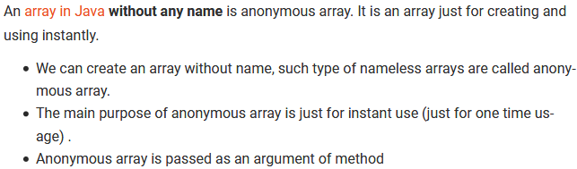
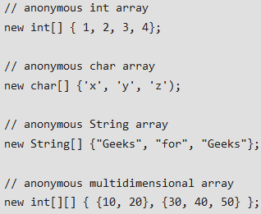
Anonymous array

Slide 14
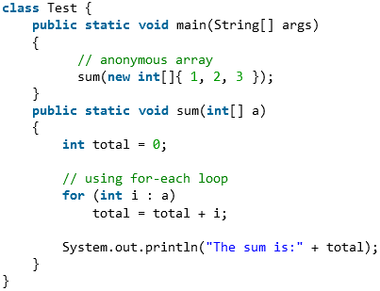
Example

Slide 15
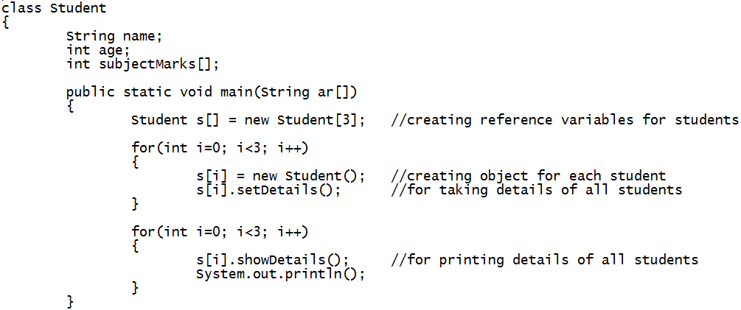
Example (creating array of objects)

Slide 16
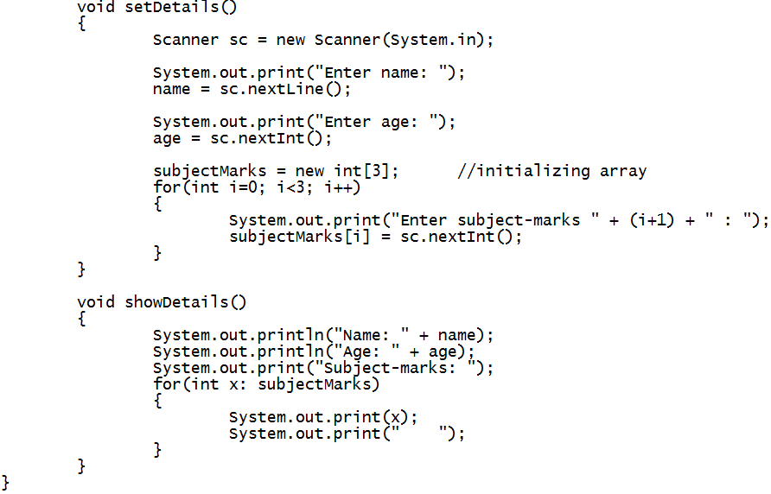

Slide 17
Exercise
Wap to make "Circle" class having instance variable “radius” and “void displayArea()” method, which is used to calculate and display area of circle. By using this class, calculate and display area of “n” circles (where "n" is specified by user).
The main() method should be present in another class called “Welcome”.

Slide 18
Exercise
Write a program to define a class named Employee with attributes: name, salary and id. Also provide a parameterized constructor to initialize all the attributes.
Create a class TestEmployee in which create at least 3 employee objects and store in an array. Implement a method public void search(int id) which display the name and salary of the employee with given id.

Slide 19
Exercise
Wap to create a restaurant menu which will display items along with its price for taking order from user.
When user selects an item, it should ask its order-quantity.
It should keep on displaying the menu until user asks to stop taking order.

Slide 20
Multi-Dimensional Array
Multidimensional arrays are arrays of arrays.
Two-Dimensional arrays are used to represent a table or a matrix.
Creating Two-Dimensional Array:
int twoD[][] = new int[4][5];

Slide 21
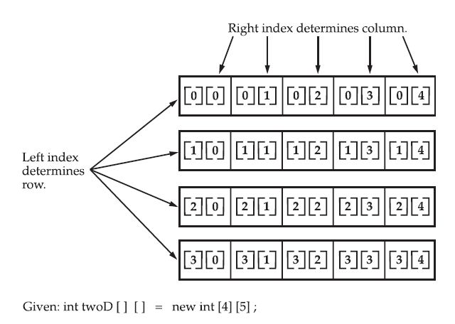
Conceptual View of 2-Dimensional Array

Slide 22
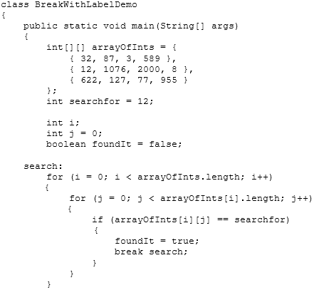
Example

Slide 23
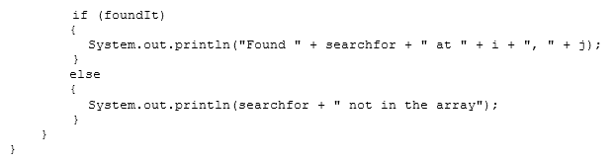

Slide 24
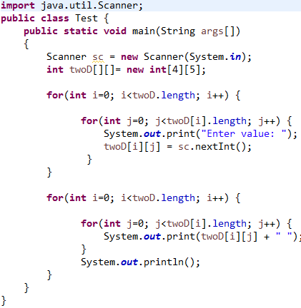
Example

Slide 25
When we allocate memory for a multidimensional array, we need to only specify the memory for the first (leftmost) dimension.
int twoD[][] = new int[4][];
The other dimensions can be assigned manually.

Slide 26
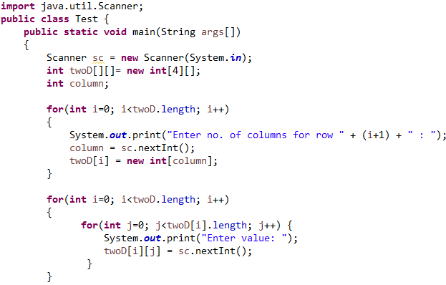
Example (jagged array)

Slide 27
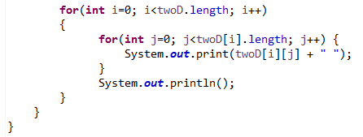

Slide 28
Exercise
Wap to store records of "n" students (using 2-D array), where each student record will contain his subject-marks
Assume that each student has pursued variable number of subject-courses.
Display all the records using enhanced for loop.
Also display average marks secured by each student (i.e. average of every row).

Slide 29
Initializing Multi-Dimensional Array
class Matrix {
public static void main(String args[]) {
double m[][] = {
{ 0*0, 1*0, 2*0, 3*0 },
{ 0*1, 1*1, 2*1, 3*1 },
{ 0*2, 1*2, 2*2, 3*2 },
{ 0*3, 1*3, 2*3, 3*3 }
};
int i, j;
for(i=0; i<4; i++) {
for(j=0; j<4; j++)
System.out.print(m[i][j] + " ");
System.out.println();
}
}
}

Slide 30
Alternative Array Declaration
type[ ] var-name;
Example:
char twod1[][] = new char[3][4];
char[][] twod2 = new char[3][4];
This alternative declaration form offers convenience when declaring several arrays at the same time.
Example: int[] nums, nums2, nums3;

Slide 31
Array Cloning
To actually create another array with its own values, Java provides the clone()method.
arr2 = arr1; (assignment)
is not equivalent to
arr2 = arr1.clone(); (cloning)
Example: ArrayCloning.java

Slide 32
Exercise
Wap to create class “Academic” having 2-D array of (M x N) size as instance variable to store the record of student. Both M and N has to be taken from as user input. Here, M: (i.e no. of rows) represents no. of subjects and N: (i.e no. of columns) represents academic tasks for each subject in a row. (Eg. Creating 3 columns would mean 3 academic tasks for each subject).
Create a main() method in separate class called “Demo” and Use the above class to create & store the record of a student by taking input from the user and display the stored record.

Slide 33
Exercise
Wap to create an application for taking order of a customer at Restaurant where user will be present with list of items as follows:
Item No. Item Price
1 Burger 50
2 Pizza 350
3 Cold-drink 20
4 Noodles 70
Take the order from the customer by asking the quantity also for each item ordered and then display the final bill.

Slide 34


